Slide 1



Fake Product Identification Using Block chain
DEPARTMENT OF
COMPUTER SCIENCE AND ENGINEERING
Batch -A8
B.DINESH KUMAR - 171061101031
M.HAARISH KUMAR - 171061101045
R.GOBINATH - 171061101606

Slide 2
ABSTRACT:
In recent years, block chain has received increasing attention and numerous applications have emerged from this technology. In our Project we use the decentralized Block chain technology approach to ensure that the consumers do not fully rely on the merchants to determine that if the products are genuine. We describe a decentralized Block chain system with products anti-counterfeiting, in that way manufacturers can use this system to provide genuine products without having to manage by direct-operated stores, which can significantly reduce the cost of product quality assurance.

Slide 3
Defnition
This project presents a data-based perspective on the perceived feasibility of block chain-based innovation and value creation for supply chain operations and trade finance. While expectations remain high across all regions and industries, none of the study participants indicated a financial or customer value benefit realization to date.

Slide 4
EXISTING SYSTEM:
The Existing system had been using the current tracking system for Product delivery. In this method the admin can take all the control, so they can modify the data and also we need go for a third party for trust and security. This system has a lot of possibility to change the real product when it’s going to a customer.

Slide 5
PROPOSED SYSTEM:
Based on the existing problems we propose the emerging technology is block chain. In our system we will enable the communication between the customer and all other departments. We will make a trusted system and we generate the script using smart contract using Ethereum Block chain. Also we introduce a the Decentralised application for making user friendly GUI for the customer to see their details.

Slide 6
SOFTWARE and HARDWARE REQUIREMENTS:
Software Requirements:
Adt bundle with eclipse
Jdk
Netbeans
My SQL
Hardware Requirements:
Storage – 20 GB or above
RAM – 4GB or Above

Slide 7
MODULES
User Interface
Database
Authentication Module
Block chain Creating and Mining

Slide 8
USER INTERFACE
The Block chain transactions and blocks can be visualized in a user interface. Creating web interface for scanning and transactions history on user interface

Slide 9
Block chain creating and mining:
On startup, create the genesis block then server initiates creation of new block and send the required data Create a new block with the scan data. Mine the block.

Slide 10
Data Flow Diagram:
manufacture
Retailer
Distributor
DB
Login/Registration
Transactions For each scanning
QR code

Slide 11
DFD DIAGRAM
LEVEL 0:
Level 1:
New product
Start
Store in DB
UI
Login
Validating with server

Slide 12
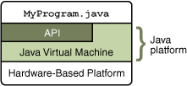

The Java Programming Language:
The Java programming language is a high-level language
that can be characterized by all of the following :
Simple
Architecture neutral
Object oriented
Portable
Distributed
High performance

Slide 13
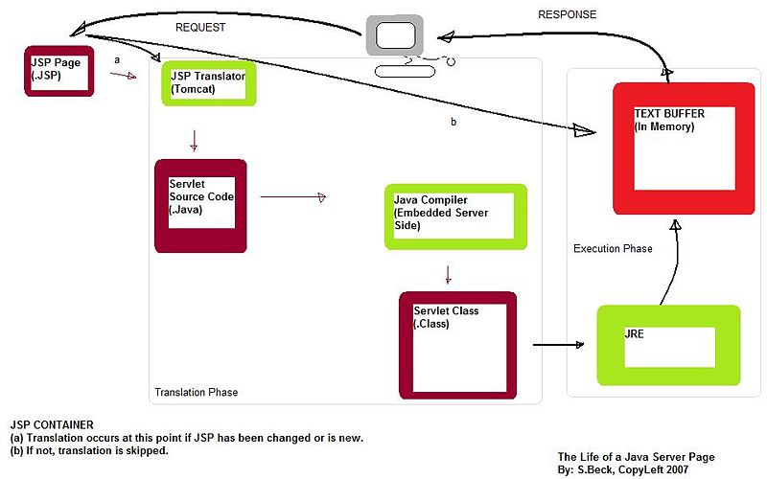
Architecture of Jsp

Slide 14
ADVANTAGE OF USING BLOCK CHAIN:
Improve the security
Make a trusted chain for privacy
Its fully de-centralised application

Slide 15
DISADVANTAGE OF USING CURRENT SYSTEM:
This system based on centralised system.
It has a less security
Data base handler can change the data

Slide 16
FUTURE ENHANCEMENTS
As we seen our projects it will work with information based. So we have to implement this project in future next level. Improve the security and implement on Real time product. In future we have to add a tracking system for track the product.

Slide 17
Conclusion:
With this system, the products journey from manufacturing to customer can be recorded, and the customer is assured that the scans weren’t faked. The Manufacture can be able to prove their product is authentic and can also able to track their product‘s pathway. The setup is easy to implement and requires less operation cost.

Slide 18
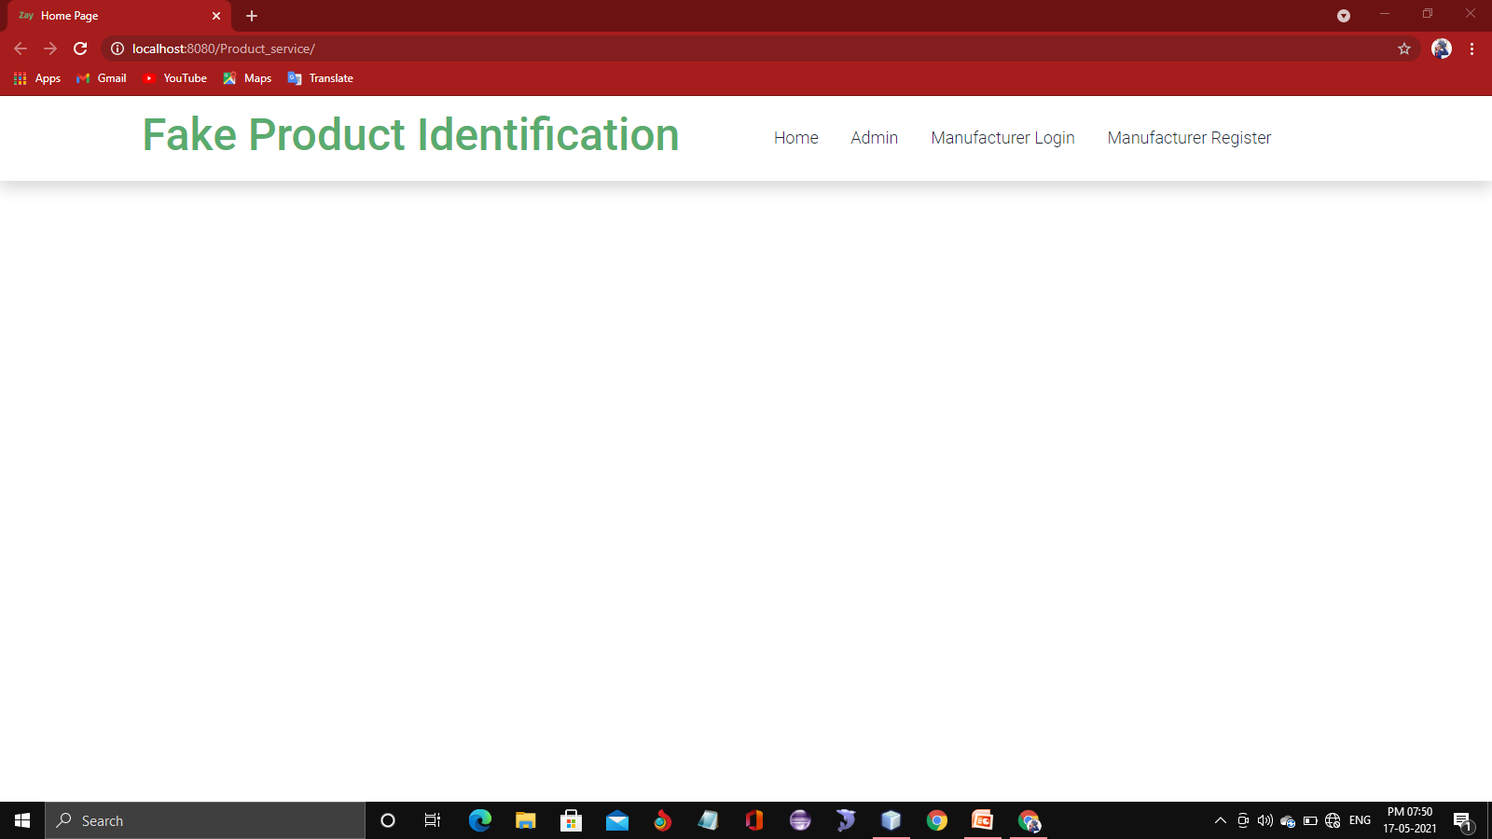
DEMO OUTPUT
HOME PAGE

Slide 19
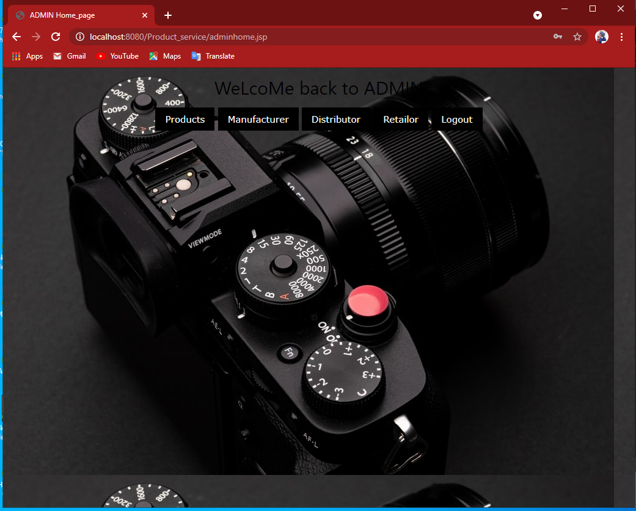
ADMIN PAGE

Slide 20
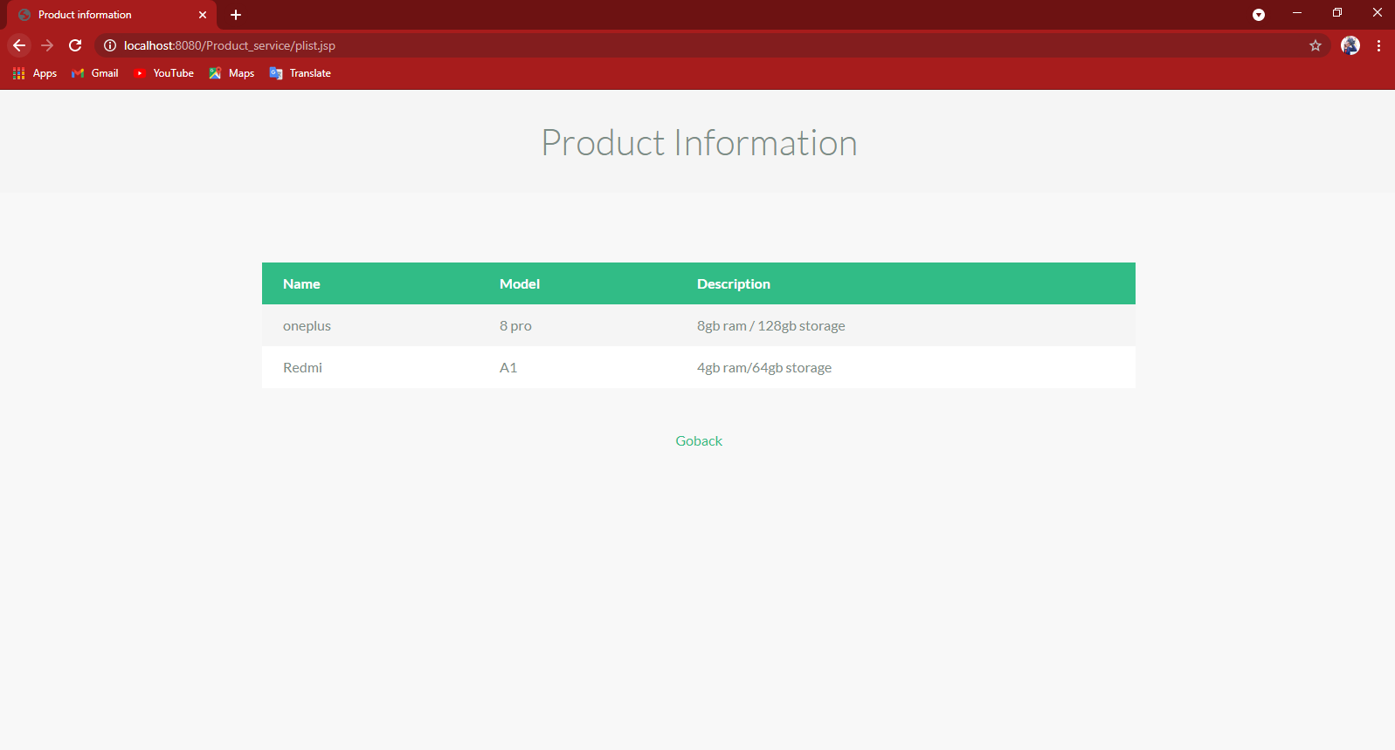
PRODUCT DETAILS

Slide 21
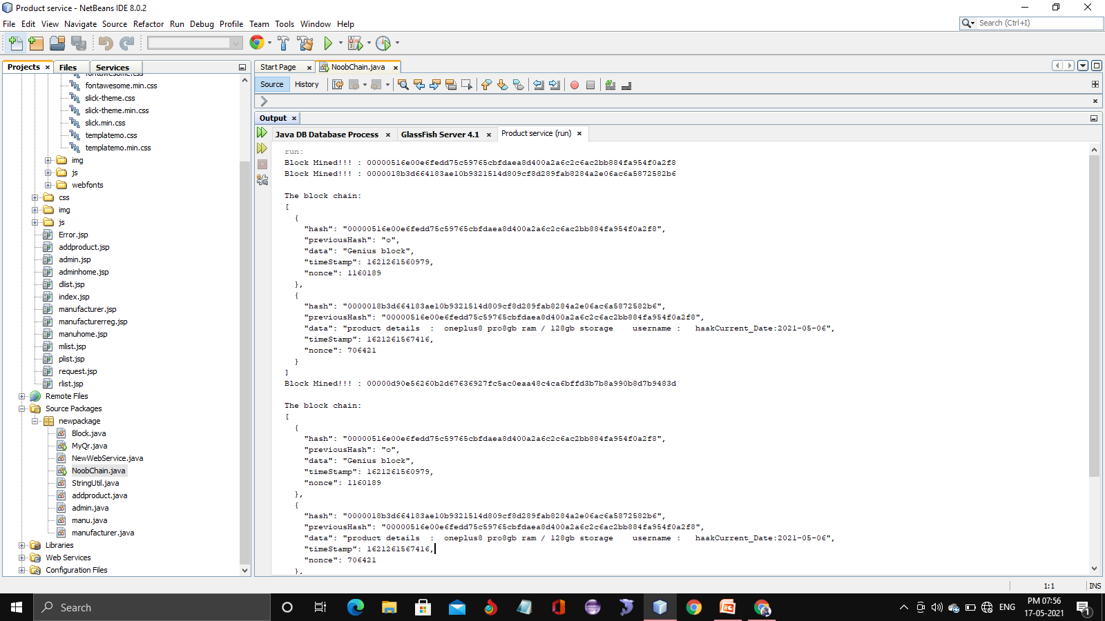
BLOCK CHAIN IMPLEMENTATION

Slide 22
REFERENCES
[1] J. A. Konstan and J. Riedl, ``Recommender systems: From algorithms to user experience,'' User Model. User-Adapted Interact., vol. 22, nos. 1_2, pp. 101_123, Apr. 2012, doi: 10.1007/s11257-011-9112-x.
[2] J. B. Schafer, D. Frankowski, J. Herlocker, and S. Sen, ``Collaborative ltering recommender systems,'' in The Adaptive Web (Lecture Notes in Computer Science), vol. 4321, P. Brusilovsky, A. Kobsa, and W. Nejdl, Eds. Cham, Switzerland: Springer, 2007.
[3] M. J. Pazzani and D. Billsus, ``Content-based recommendation systems,''
in The Adaptive Web (Lecture Notes in Computer Science), vol. 4321, P. Brusilovsky, A. Kobsa, and W. Nejdl, Eds. Berlin, Germany: pringer,2007.
[4] S.-T. Li, T.-T. Pham, and H.-C. Chuang, ``Do reviewers' words affect predicting their helpfulness ratings? Locating helpful reviewers by linguistics styles,'' Inf. Manage., vol. 56, no. 1, pp. 28_38, 2019.
[5] V. Srivastava and A. D. Kalro, ``Enhancing the helpfulness of online consumer reviews: The role of latent (content) factors,'' J. Interact. Marketing, vol. 48, pp. 33_50, Nov. 2019.

